Slide 1
AVENGERS
AMES HOUSE PRICE
PREDICTION

Slide 2
BACKGROUND OF STUDY
The average house price in Ames was $180,921 were found by a study conducted in August 2020 and the prices were influenced by quality of house, neighbourhood, size of the house. Over the course of the year, the selling price could result in additional costs over $800,000 and lead to different factors influenced it.
Research in 2011 explained that, some families need to measure and determine how much money they have in order to achieve an acceptable standard of living. Consumers need to adjust their preference of house based on their budget.

Slide 3
CONTENTS OF THIS CASE STUDY
Here’s what you’ll find in this study:
Data Description
Problem Statements
Exploratory Data Analysis
Research Methodology
Results and Findings
Demonstration Video

Slide 4
DATA DESCRIPTION
ABSTRACT
2930
DATA SIZE
81
FEATURES
Data from Ames Assessor’s Office for individual residential properties sold in Ames, IA from 2006-2010
Total number of observations in the data set.
23 nominal, 23 ordinal, 14 discrete, 20 continuous variables and 1 identifier

Slide 5
PROBLEM STATEMENTS
DEVELOPER’S
CONSUMER’S
Determine the estimated market house price to avoid overpricing
Find factors that affecting sale price of house
AVENGERS
Assist customer to choose a house based on their preferences and budget

Slide 6

Data Exploratory Analysis
Number of columns
81
Number of rows
2930
Number of object data
43
Number of numeric data
38

Slide 7
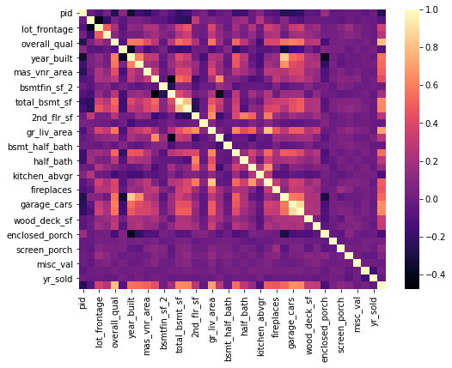
Correlated features and its data
Features | Correlation
Overall Quality | 80%
Garage Living Area | 71%
Garage Cars | 65%
Garage Area | 64%
Total Basement SF | 63%
1st Floor SF | 62%
Year Built | 56%
Full Bath | 55%
Year Remodelled | 53%

Slide 8
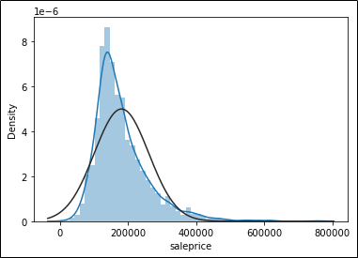
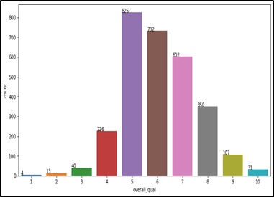
skewness : 1.74
Count of Overall Quality by Sales Price
Shows correlation between the Features

Slide 9
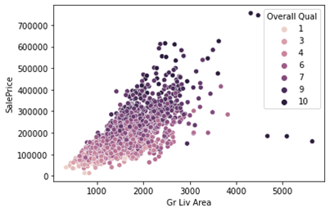
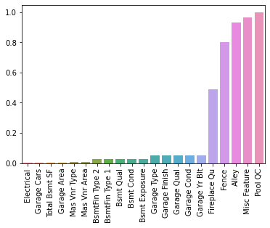
METHODOLOGY
1. CORRELATION
2. OUTLIER
3. MISSING DATA

Slide 10
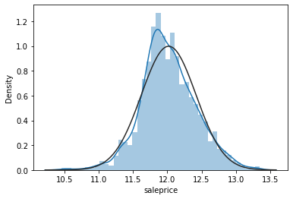
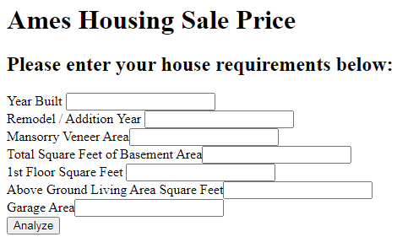
METHODOLOGY
5. MODEL TESTING
4. DATA ENCODING
6. MODEL DEPLOYMENT
Adjust Skewness - Log Transformation
Ex Excellent 4
Gd Good 3
TA Average 2
Fa Fair 1
Po Poor 0
Ridge Regression
Cross Validation
Grid Search
(Elastic Net)
Lasso Regression Cross Validation

Slide 11
SOLUTIONS
So, what is the Solution???
Web application that able to predict up to 86% accuracy.
Only using 13 important features.
Customers able to tweak the features freely based on their budget.

Slide 12
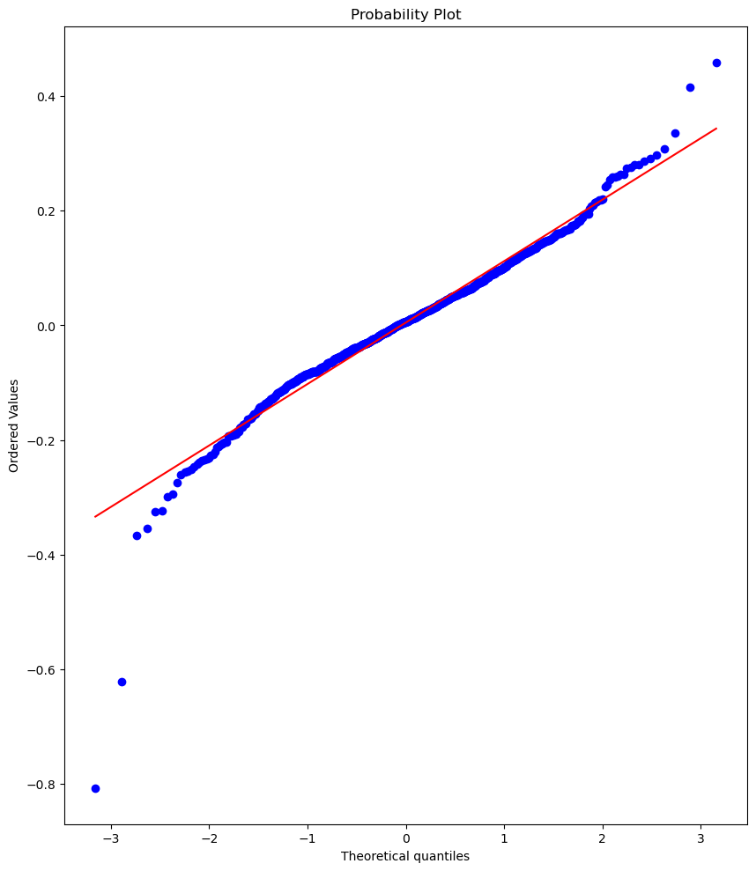
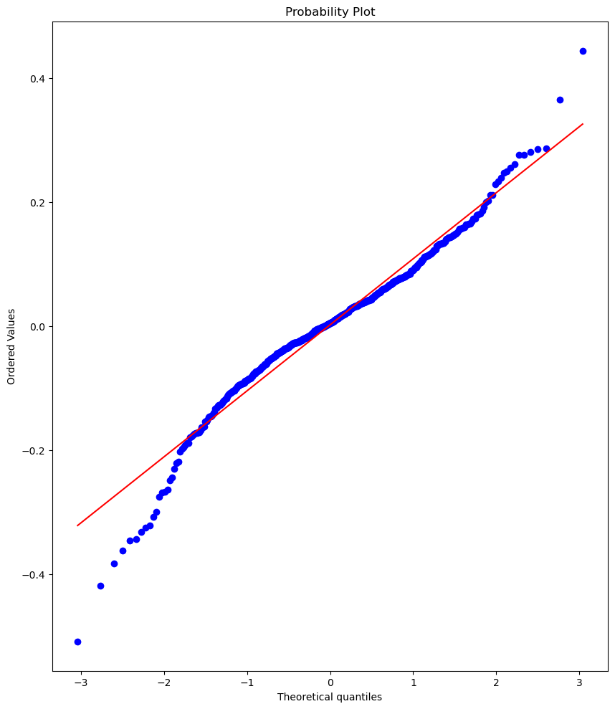
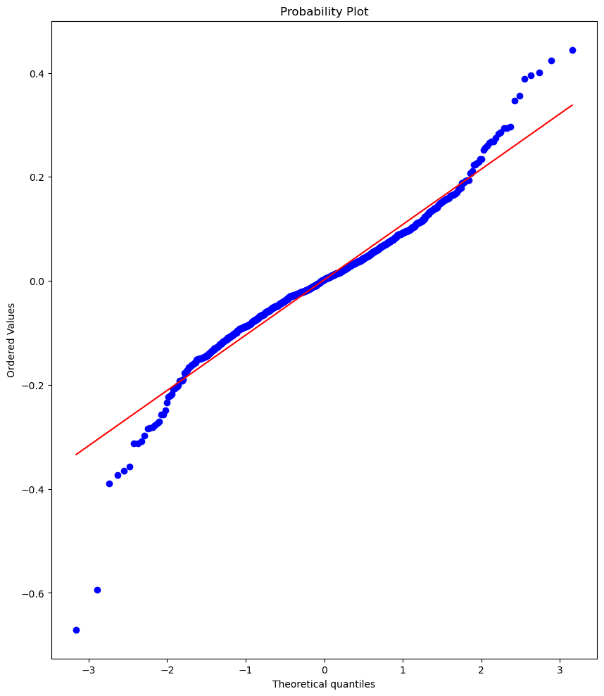
COMPARING THE MODEL
MODEL 1
GRID SEARCH CV (ELASTIC NET)
MODEL 3
RIDGE CV
MODEL 2
LASSO CV
It have lower accuracy and error percentage compared to Lasso CV.
It reduce the overfitting, but used a lot of features. Model would be too complex
ACC = 93%
ACC = 92%
ERROR
PERCENTAGE
= 0.65%
ACC = 92%
ERROR
PERCENTAGE
= 0.67%
ERROR
PERCENTAGE
= 2.56%
RMSE = 0.11
RMSE = 0.11
RMSE = 0.11

Slide 13
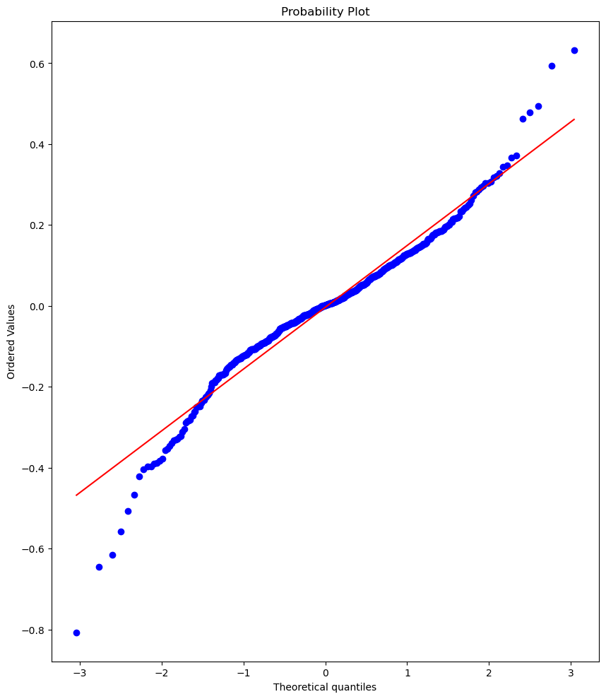
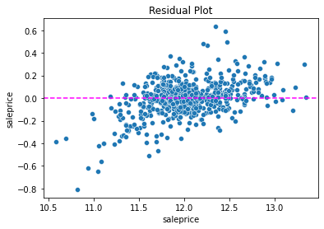
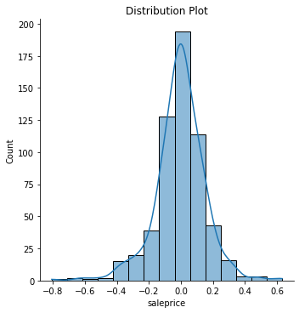
SELECTING THE BEST MODEL (FINAL MODEL)
LASSO CV
ACC = 86%
No. of features for final model had been reduced
Less features, Less complex
Use only 13 important features
Add some bias in the model to reduce overfitting
ERROR
PERCENTAGE
= 0.90%
RMSE = 0.15

Slide 14
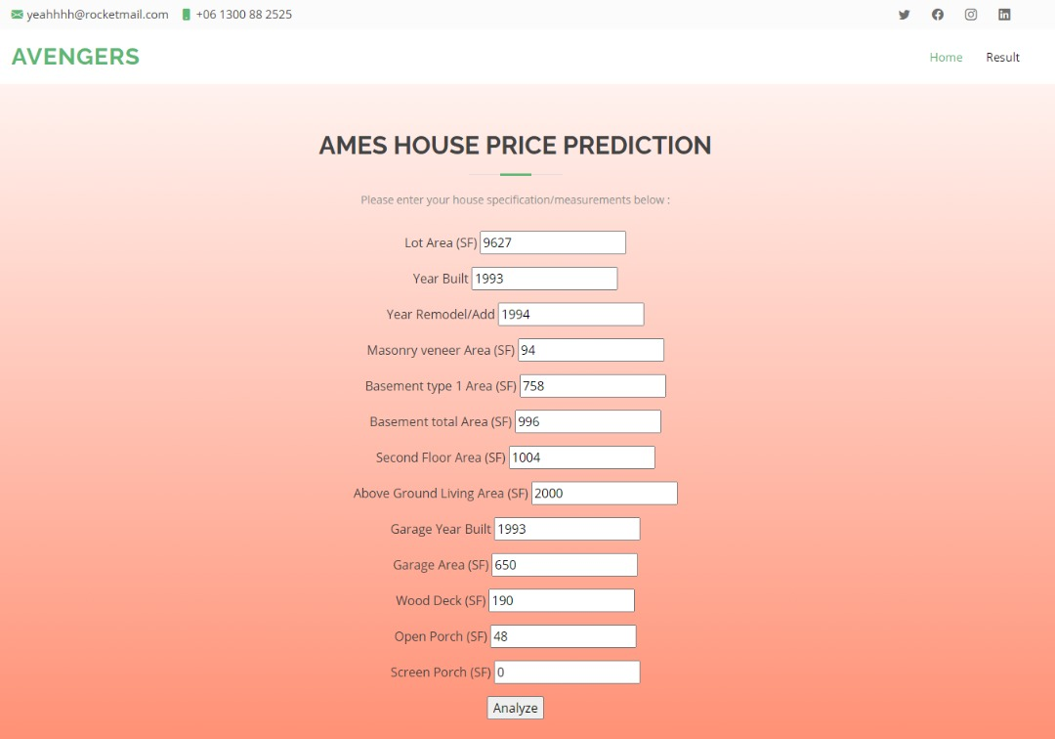
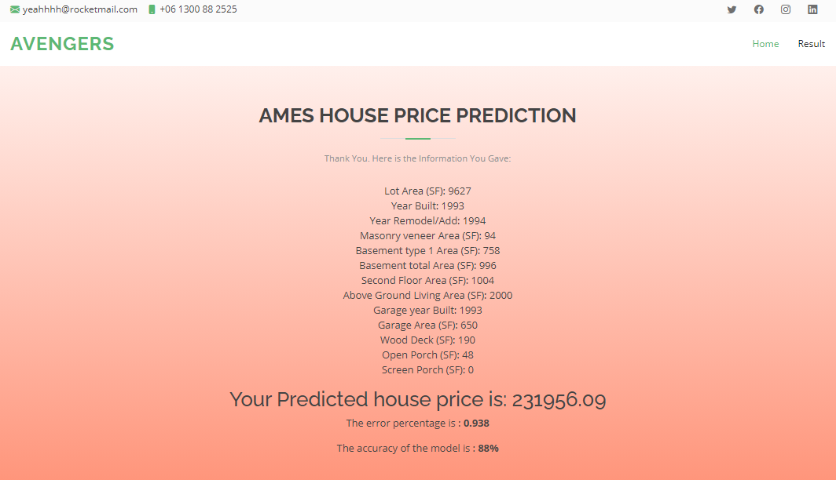
HOW TO USE IT??
Fill in the form with preferred value according to its respective units
Click the ‘Analyze’ button to generate the prediction
Return the predicted sale price along with the filled value for checking
Return the percentage error and accuracy of prediction

Slide 15
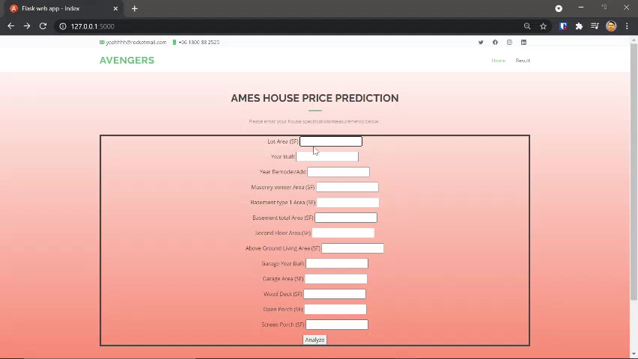
WEB APP DEMO

